Slide 1


Great Climates, Big Cities?
Kansas Populations: a look at employment and unemployment, correlation between poverty and household income, wealth, weather, migration

Slide 2
Topic: Unemployment Rates and Poverty Data
Question
find by numbers how are levels of employment and unemployment in Kansas to recognize how extent of opportunities or not?
what the correlation between poverty rate and household income?
Discovery process

Slide 3

Data Analysis Approach
Focus on Kansas City.
Focus on population of poverty, and household income from USDA.
Use poverty estimates for the U.S., States, and counties, 2018 dataset from the USDA.
This Photo by Unknown Author is licensed under CC BY-SA

Slide 4
Documentation
https://public.opendatasoft.com/
https://www.ers.usda.gov/data-products/county-level-data-sets/download-data/
Unemployment and median household income for the U.S., States, and counties, 2000-19
Poverty estimates for the U.S., States, and counties, 2018

Slide 5
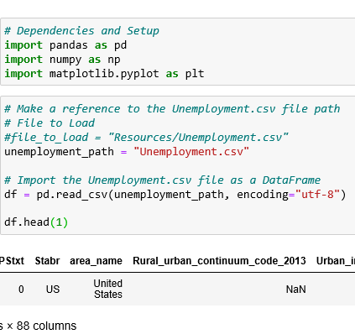
Let’s go into coding!
Pandas as pd
numpy as np
Matplotlib.pyplot as plt

Slide 6
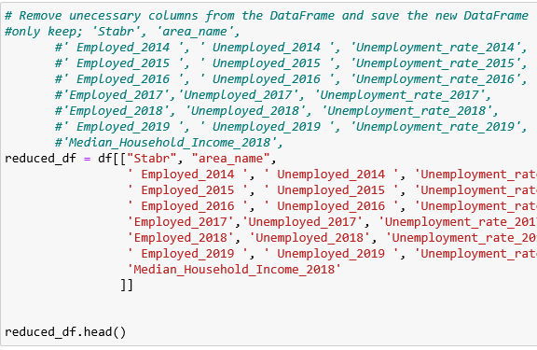
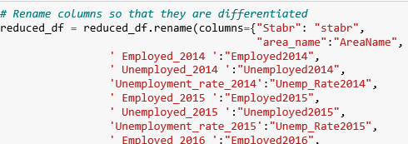
Clean up unnecessary columns and rename

Slide 7
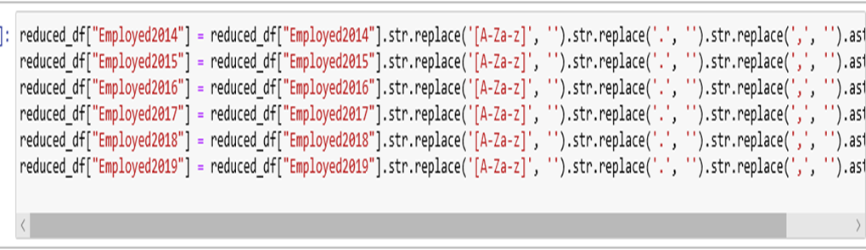
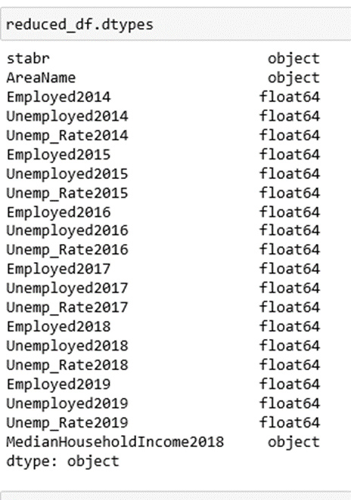
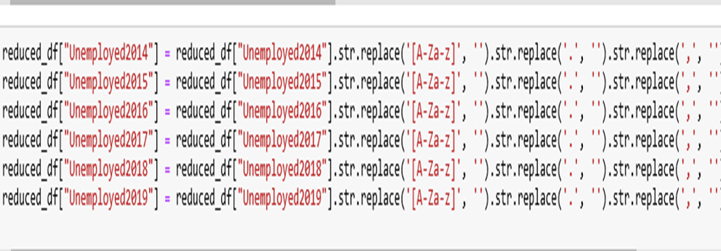
Obstacles:

Slide 8
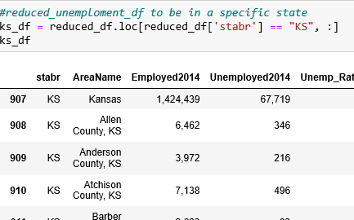
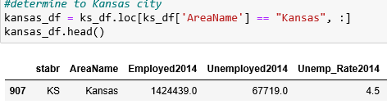
Determine specific row, Kansas
Determine specific column, KS

Slide 9
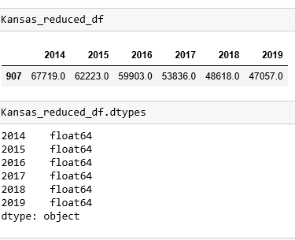
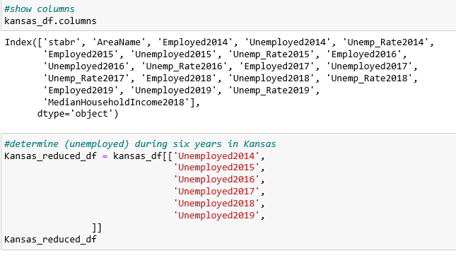
Make sure columns names and numbers is numeric

Slide 10
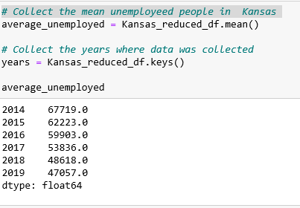
Calcolate the means for each employeed and unemployed .

Slide 11
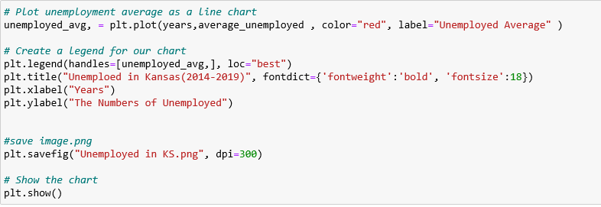
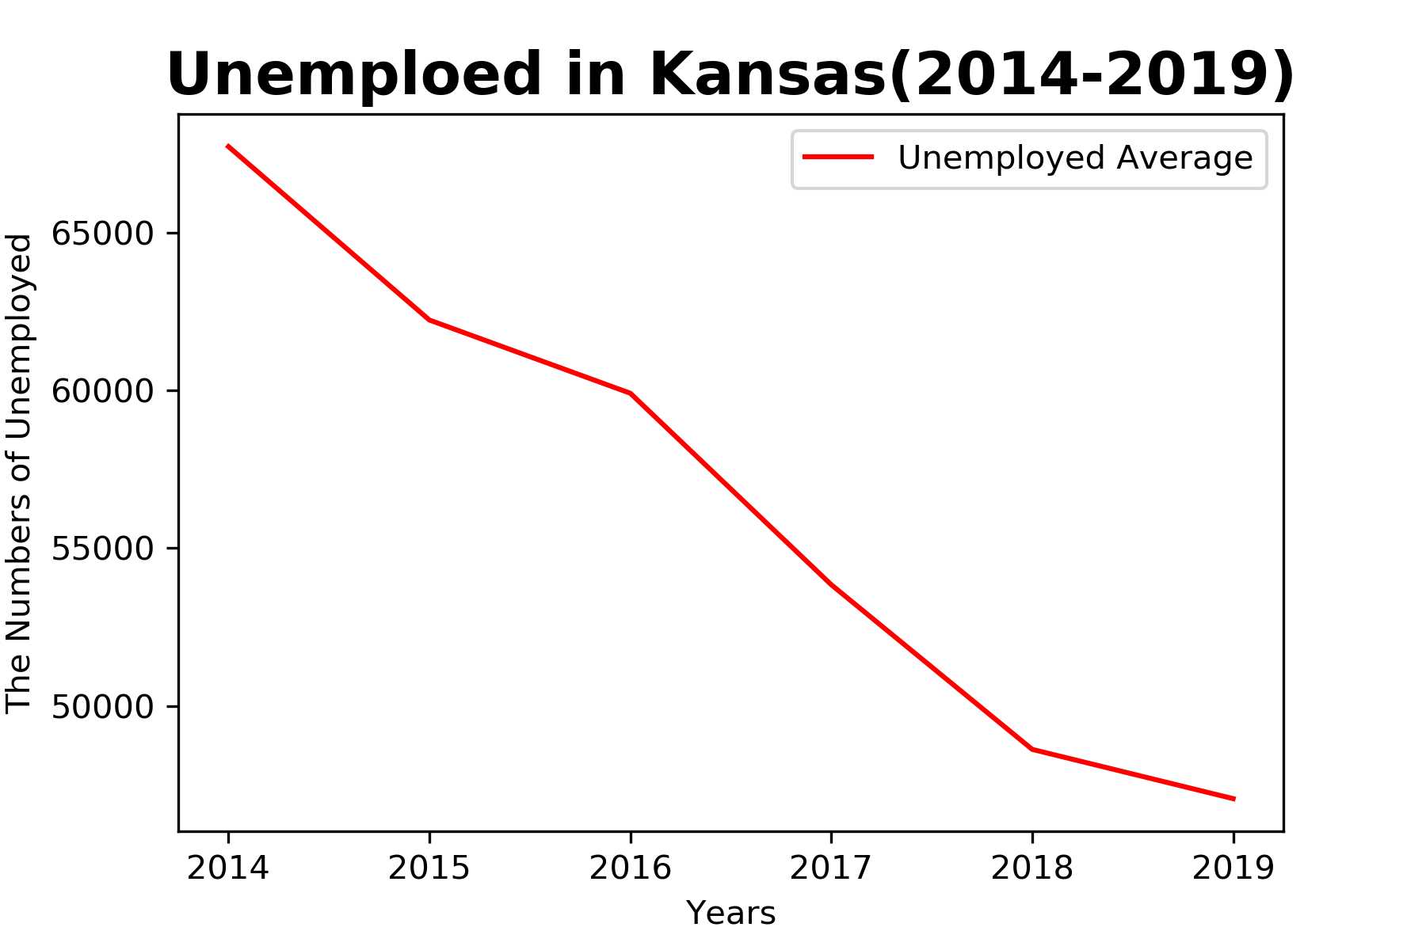
Create line plot:
Unemployed in Kansas from 2014 -2019 :

Slide 12
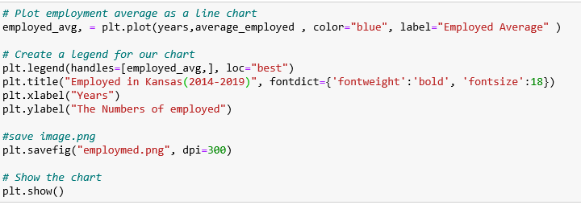
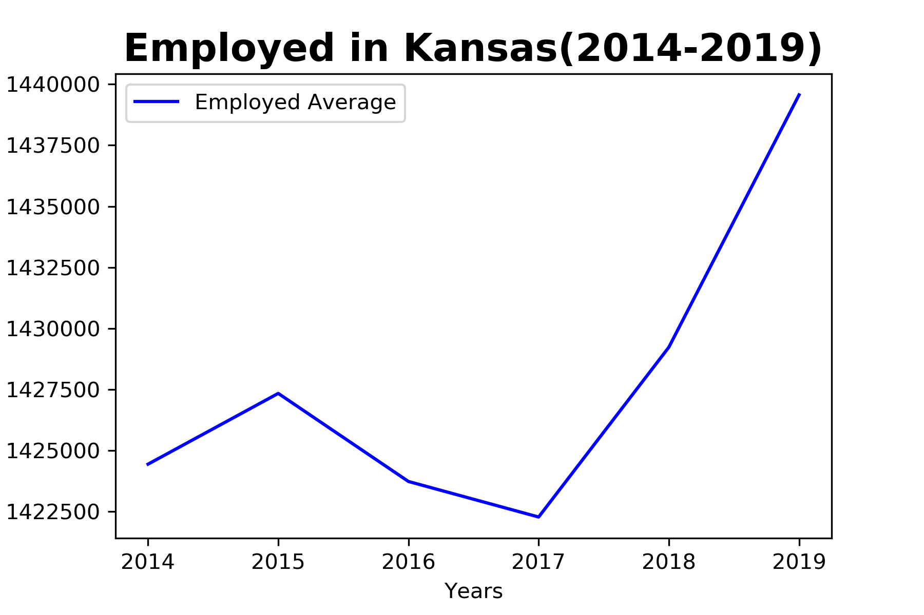
Employed in Kansas during six years ago: (2014-2019):

Slide 13
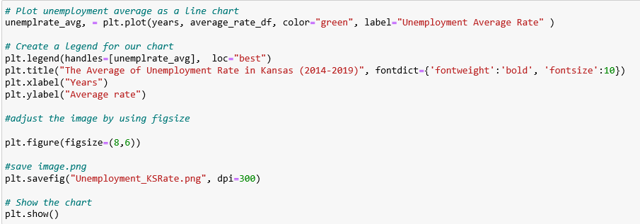
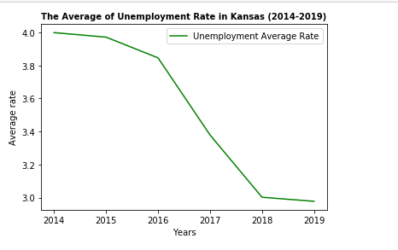
The average of unemployment rate :

Slide 14
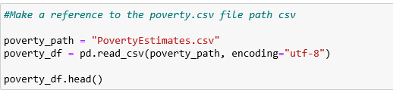
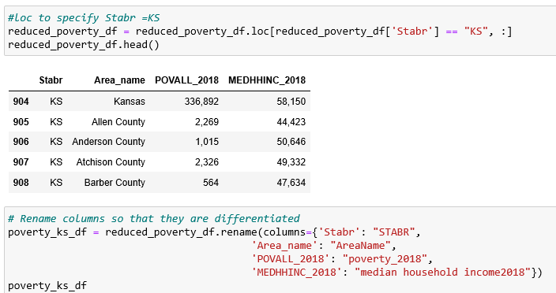
The corolation between poverty and median household income in KS:

Slide 15
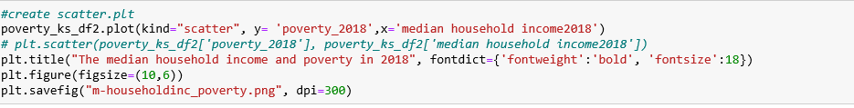
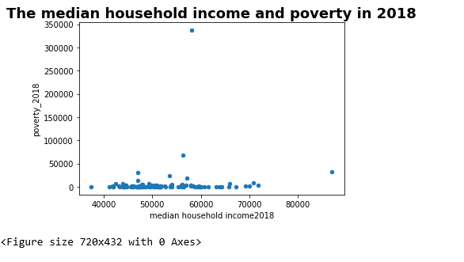

Slide 16
Is the temperature of a city metropolitan area hottest downtown?
Observations made in Sacramento, CA
Downtown temperatures always seemed hotter than surrounding areas.
Data Analysis Approach
Focus on Kansas City, MO and the surrounding metropolitan area
Use temperature data from OpenWeather API
Use population data from the Census Bureau

Slide 17
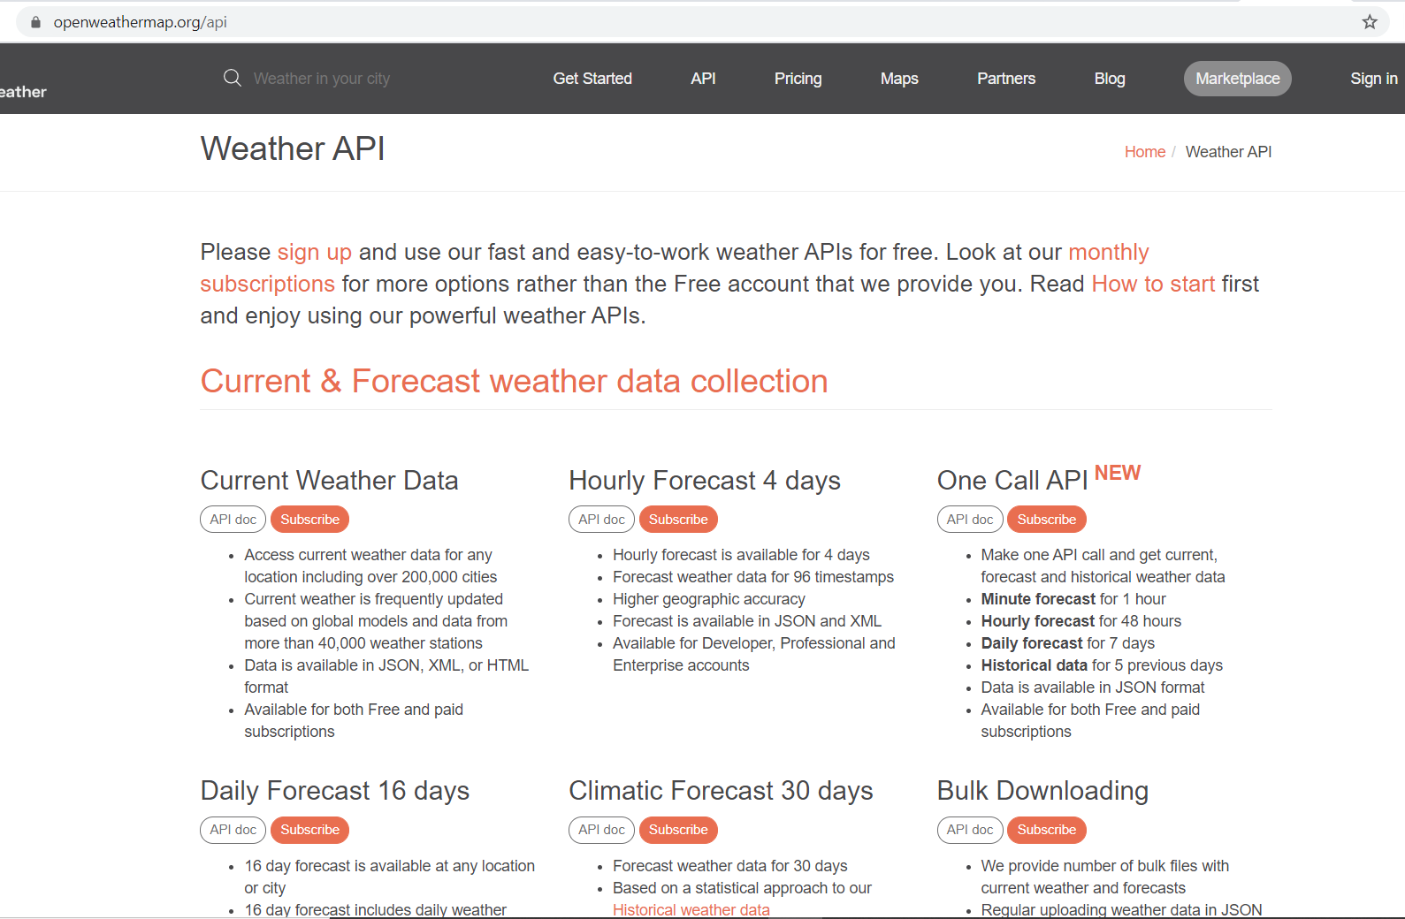
Data source used for gathering temperature data was the Open Weather API
5 day history

Slide 18
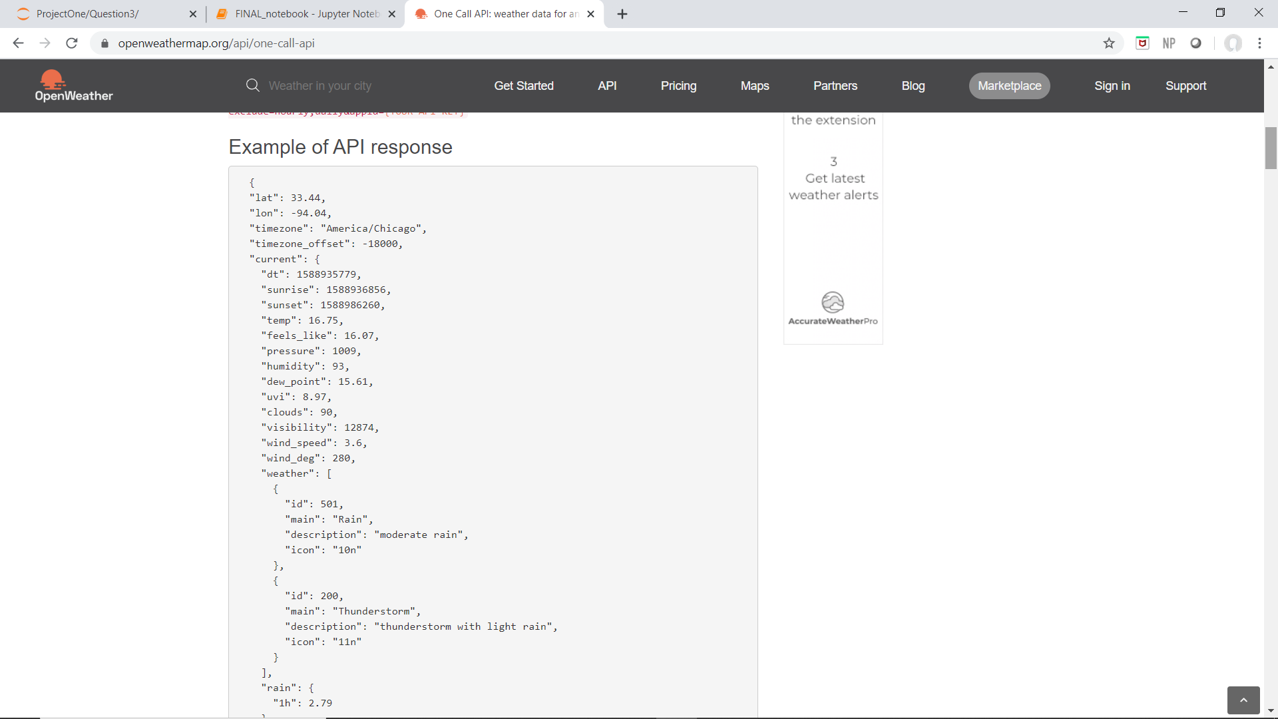
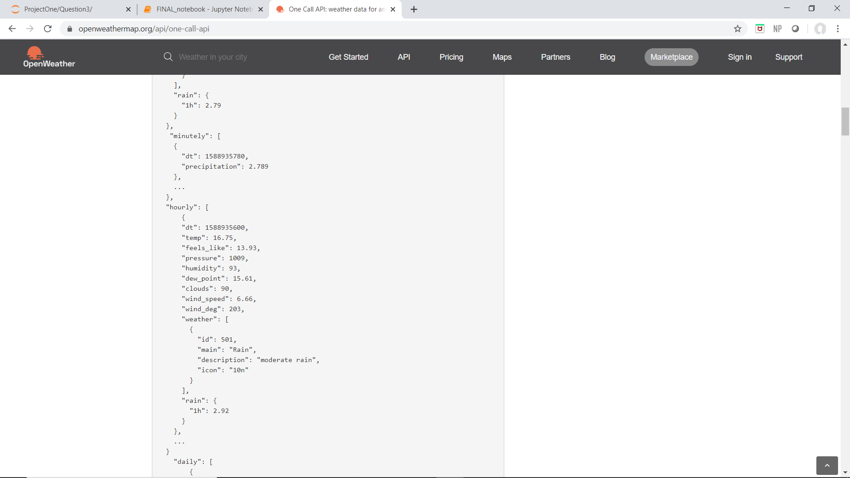
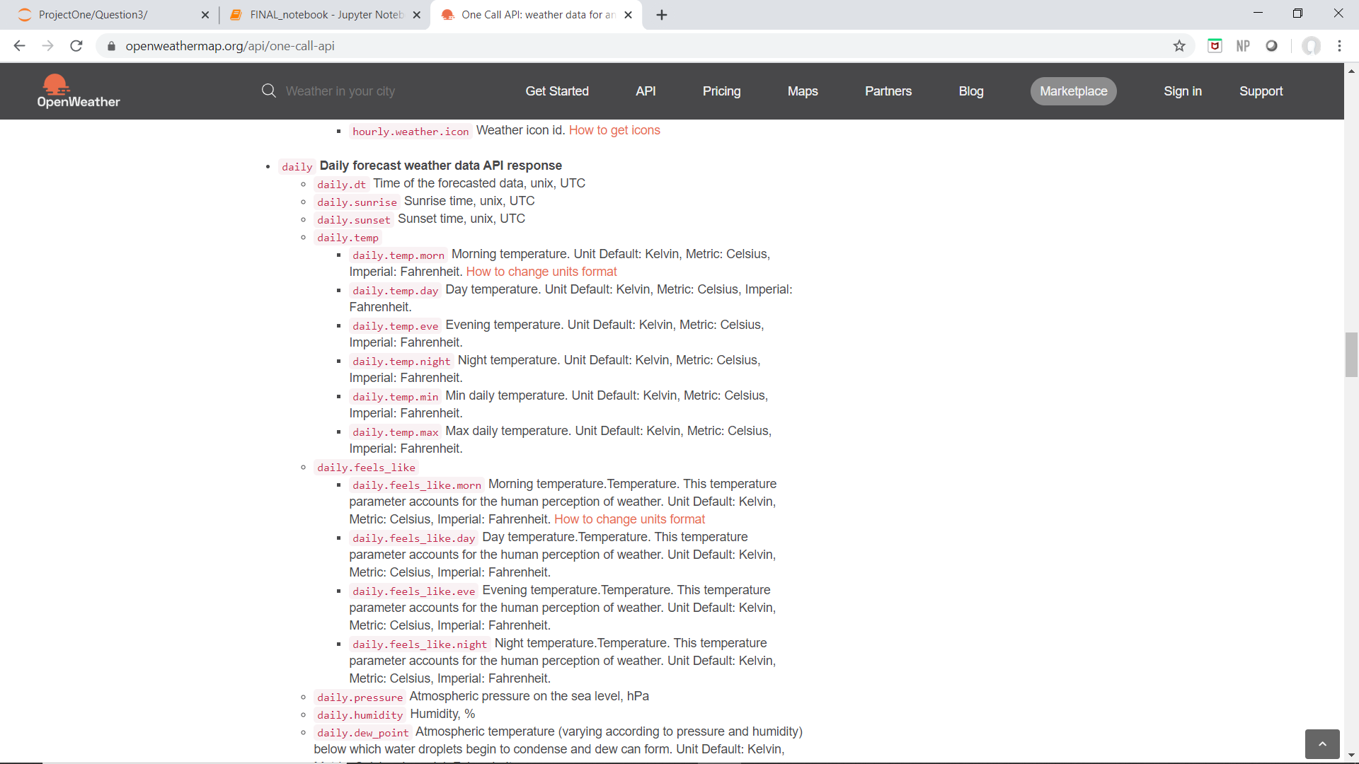
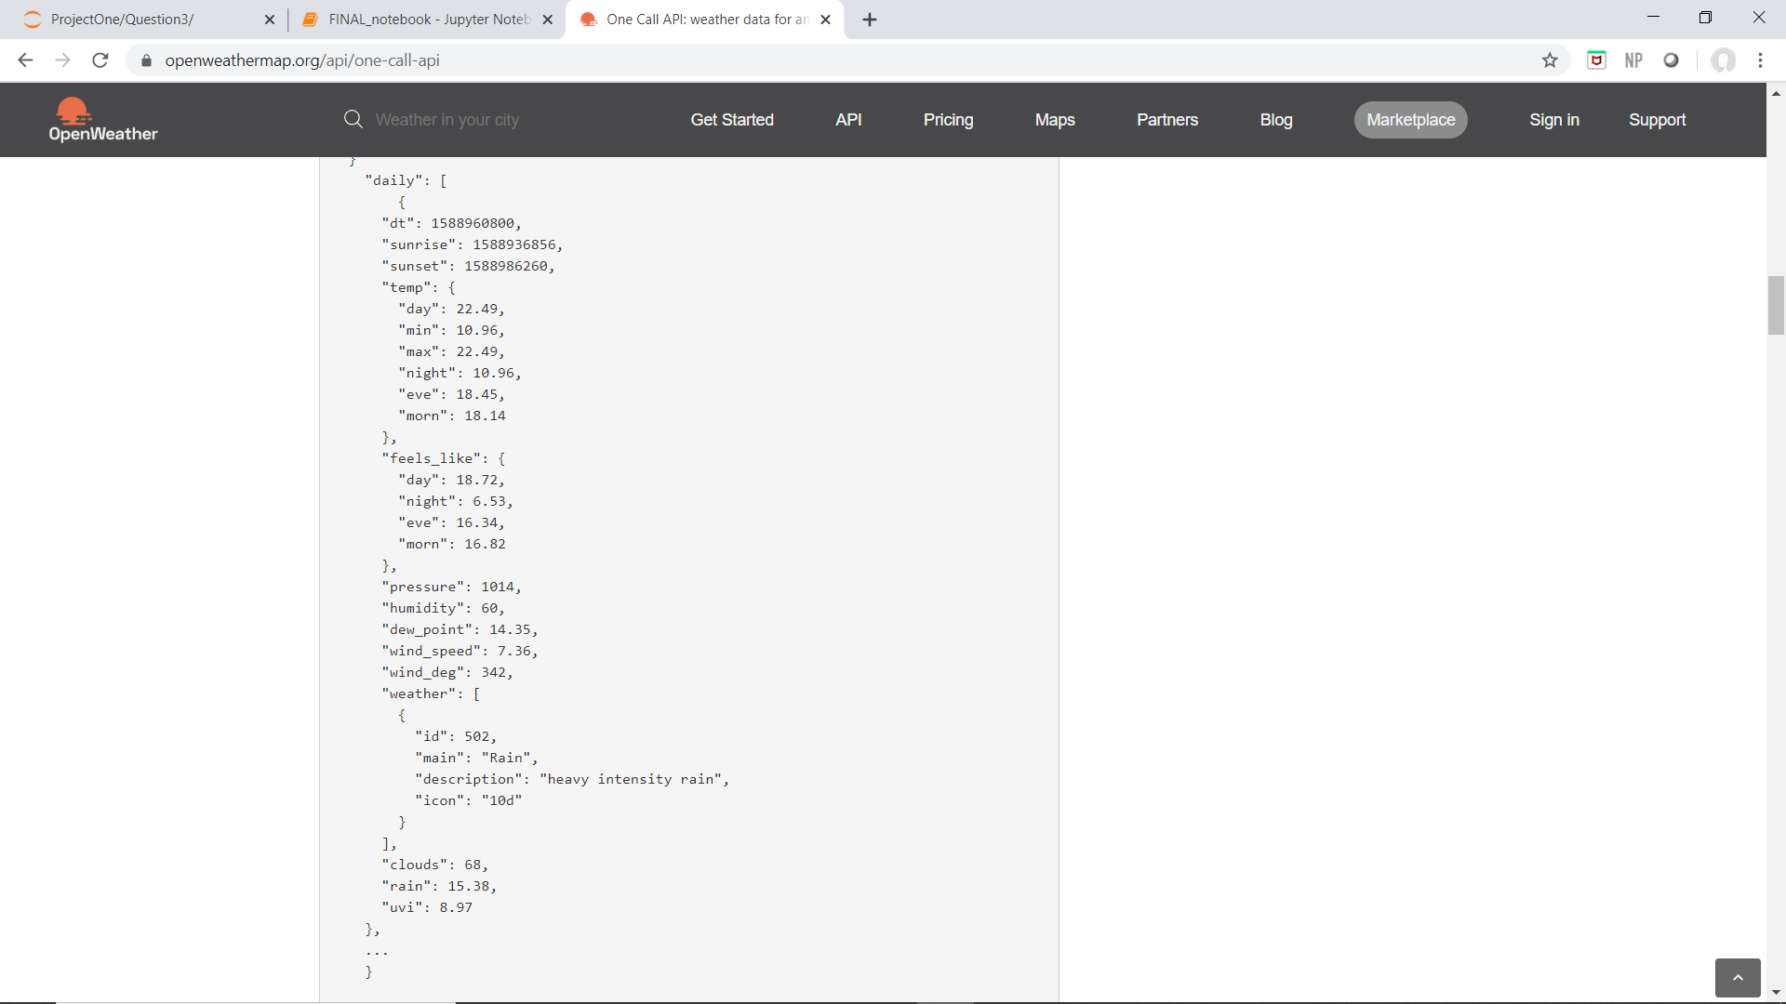
Open Weather API
Daily High Temp

Slide 19
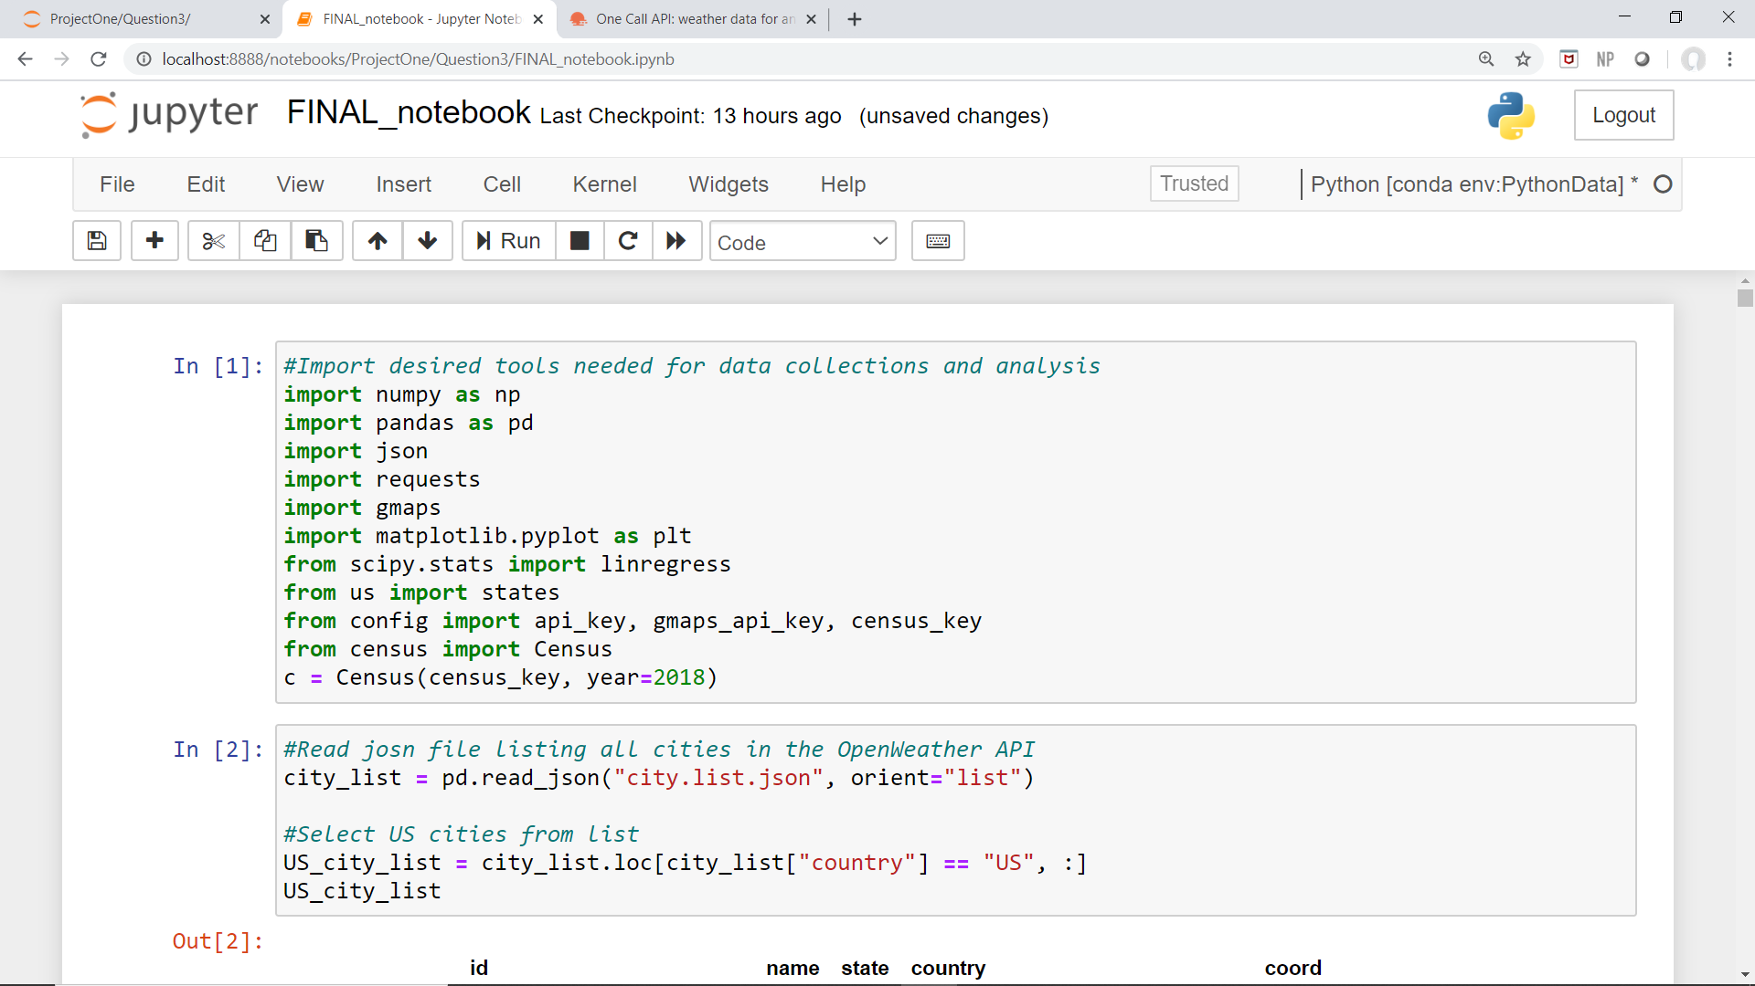
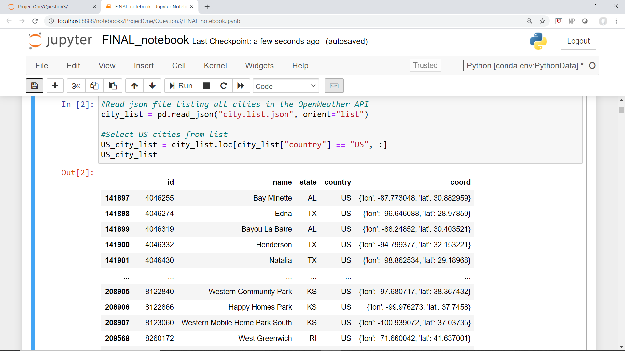
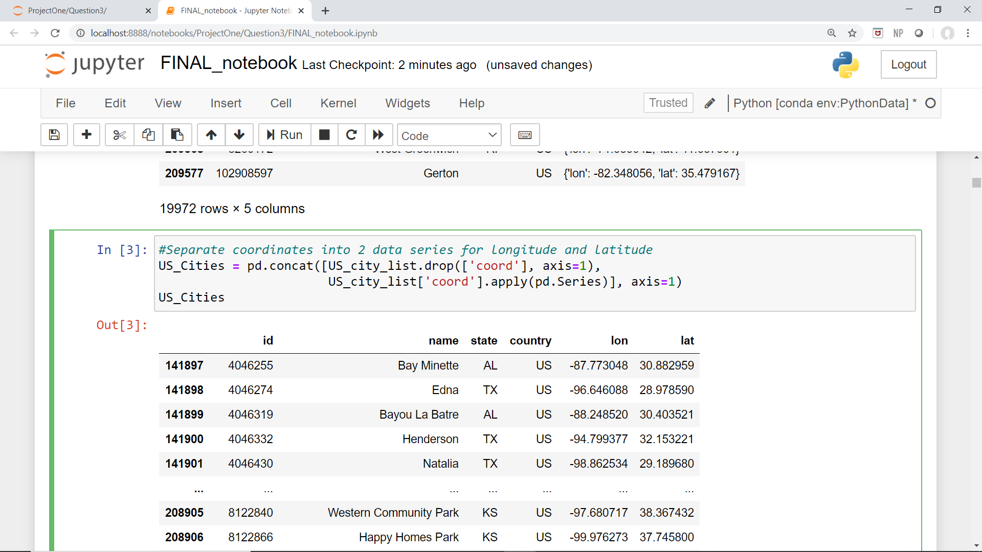
Jupyter Notebook
Import modules and passwords
Read JSON file with list of every city in OpenWeather 5 day history data set
Need to separate “coord” into latitude and longitude
Use .apply(pd.Series) to convert dictionaries to series

Slide 20
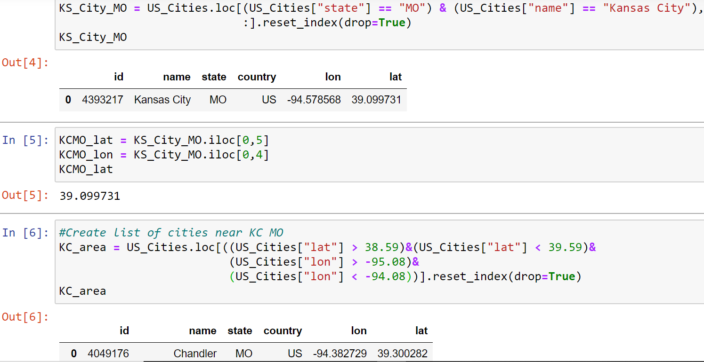
Find Kansas City, MO
Store coordinates in variables
Narrow list from US cities to only cities within +/- 0.5 deg latitude and longitude of KC, MO
Use name, lon, and lat data to query OpenWeather API for high temperatures over the last 5 days in KC, MO and the surrounding cities.

Slide 21
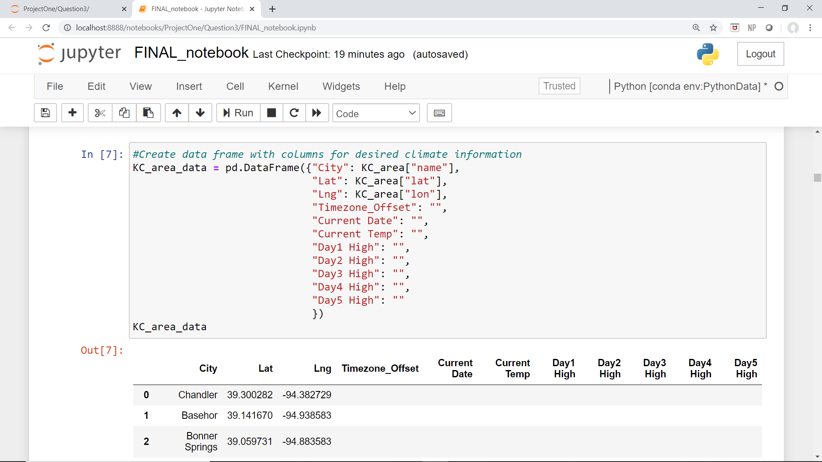
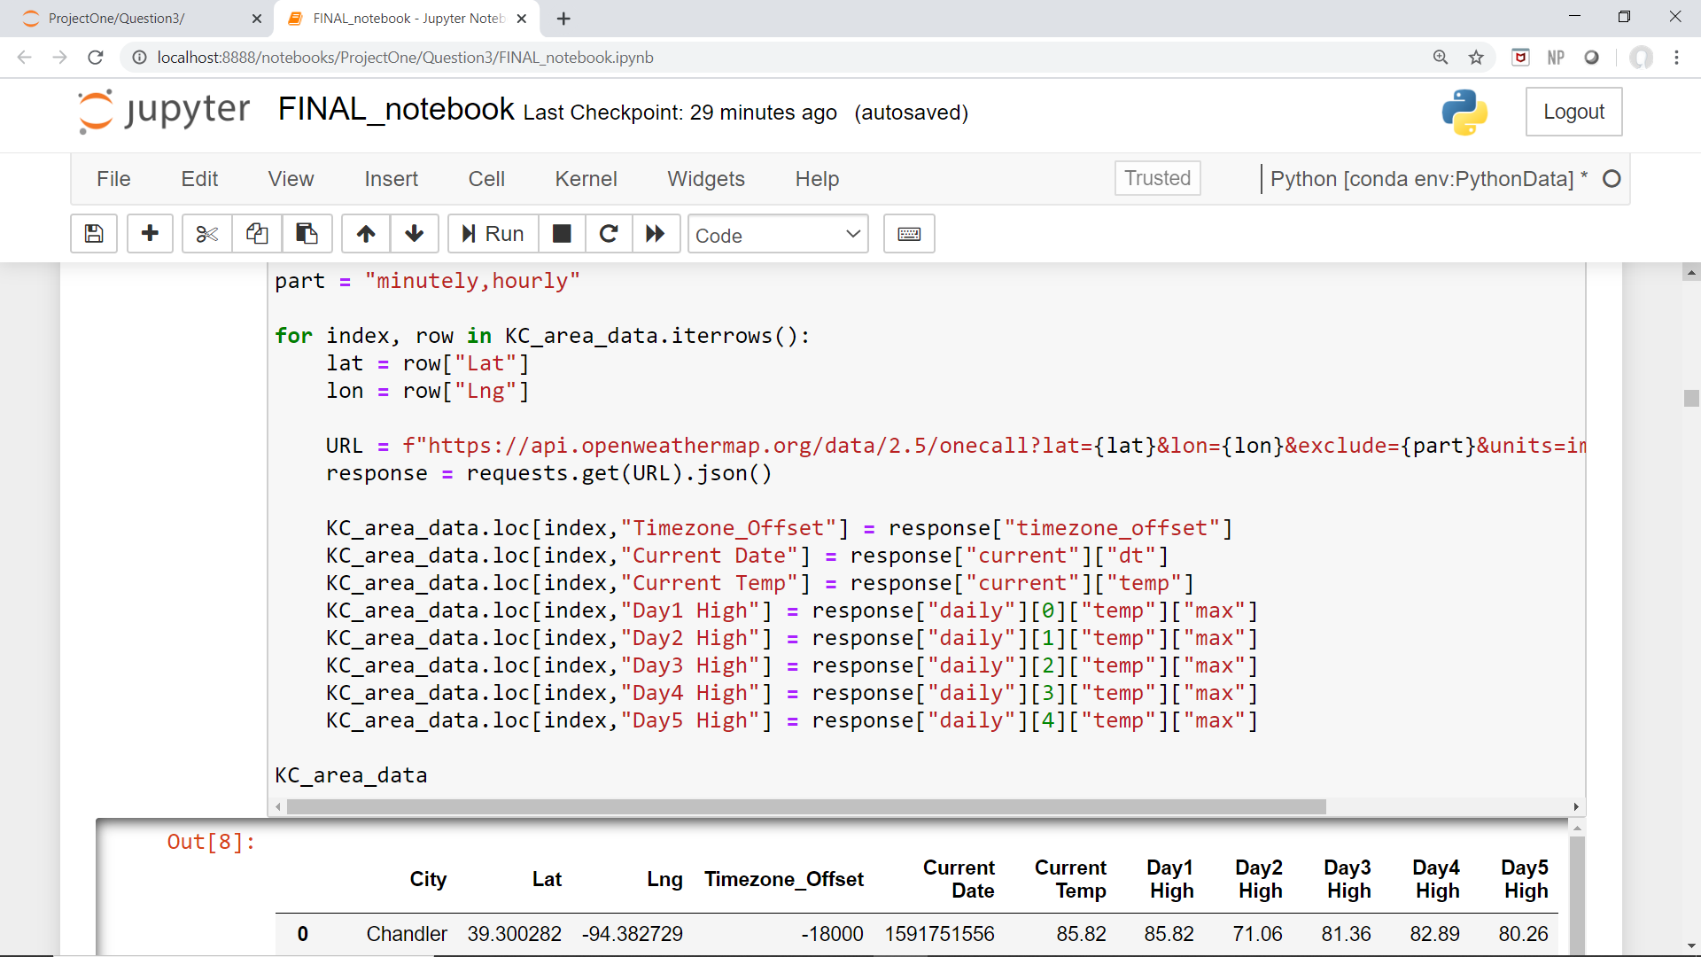
Create new dataframe to store weather data
Import OpenWeather API data

Slide 22
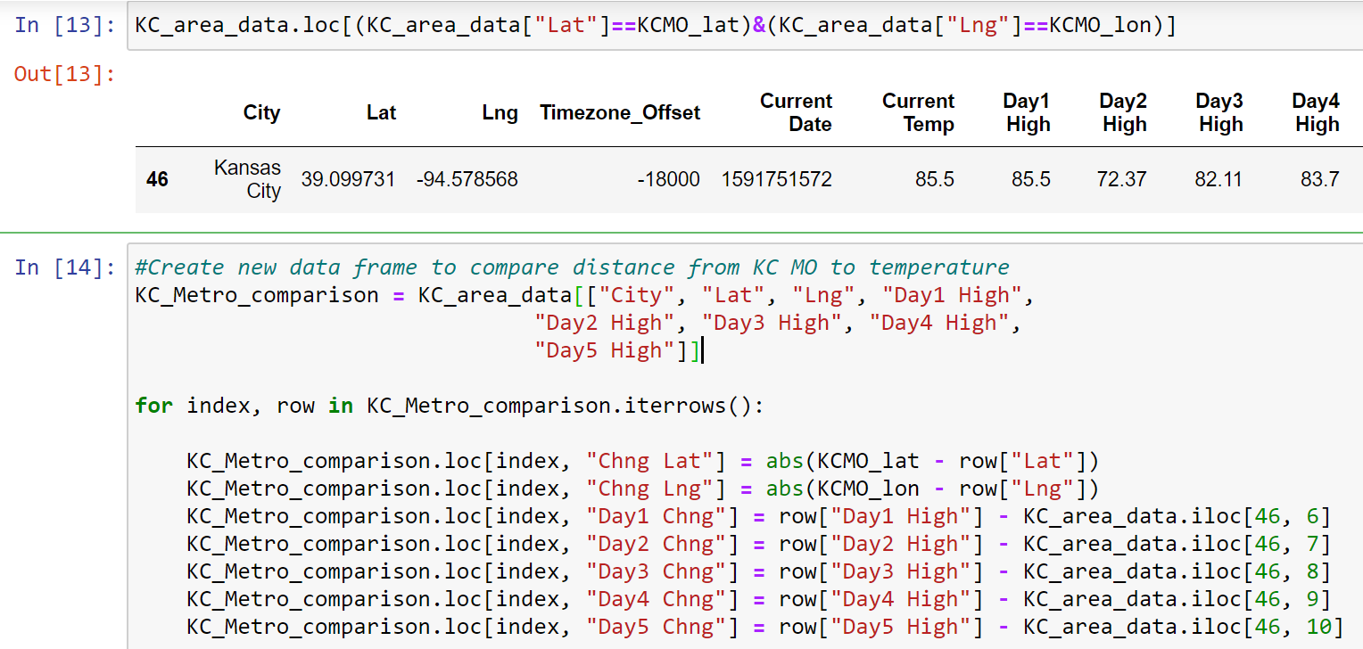
Compare location and temperatures of each city to downtown Kansas City
Locate KC, MO within dataframe
Calculate distance using latitude and longitude
Calculate change in temperature

Slide 23
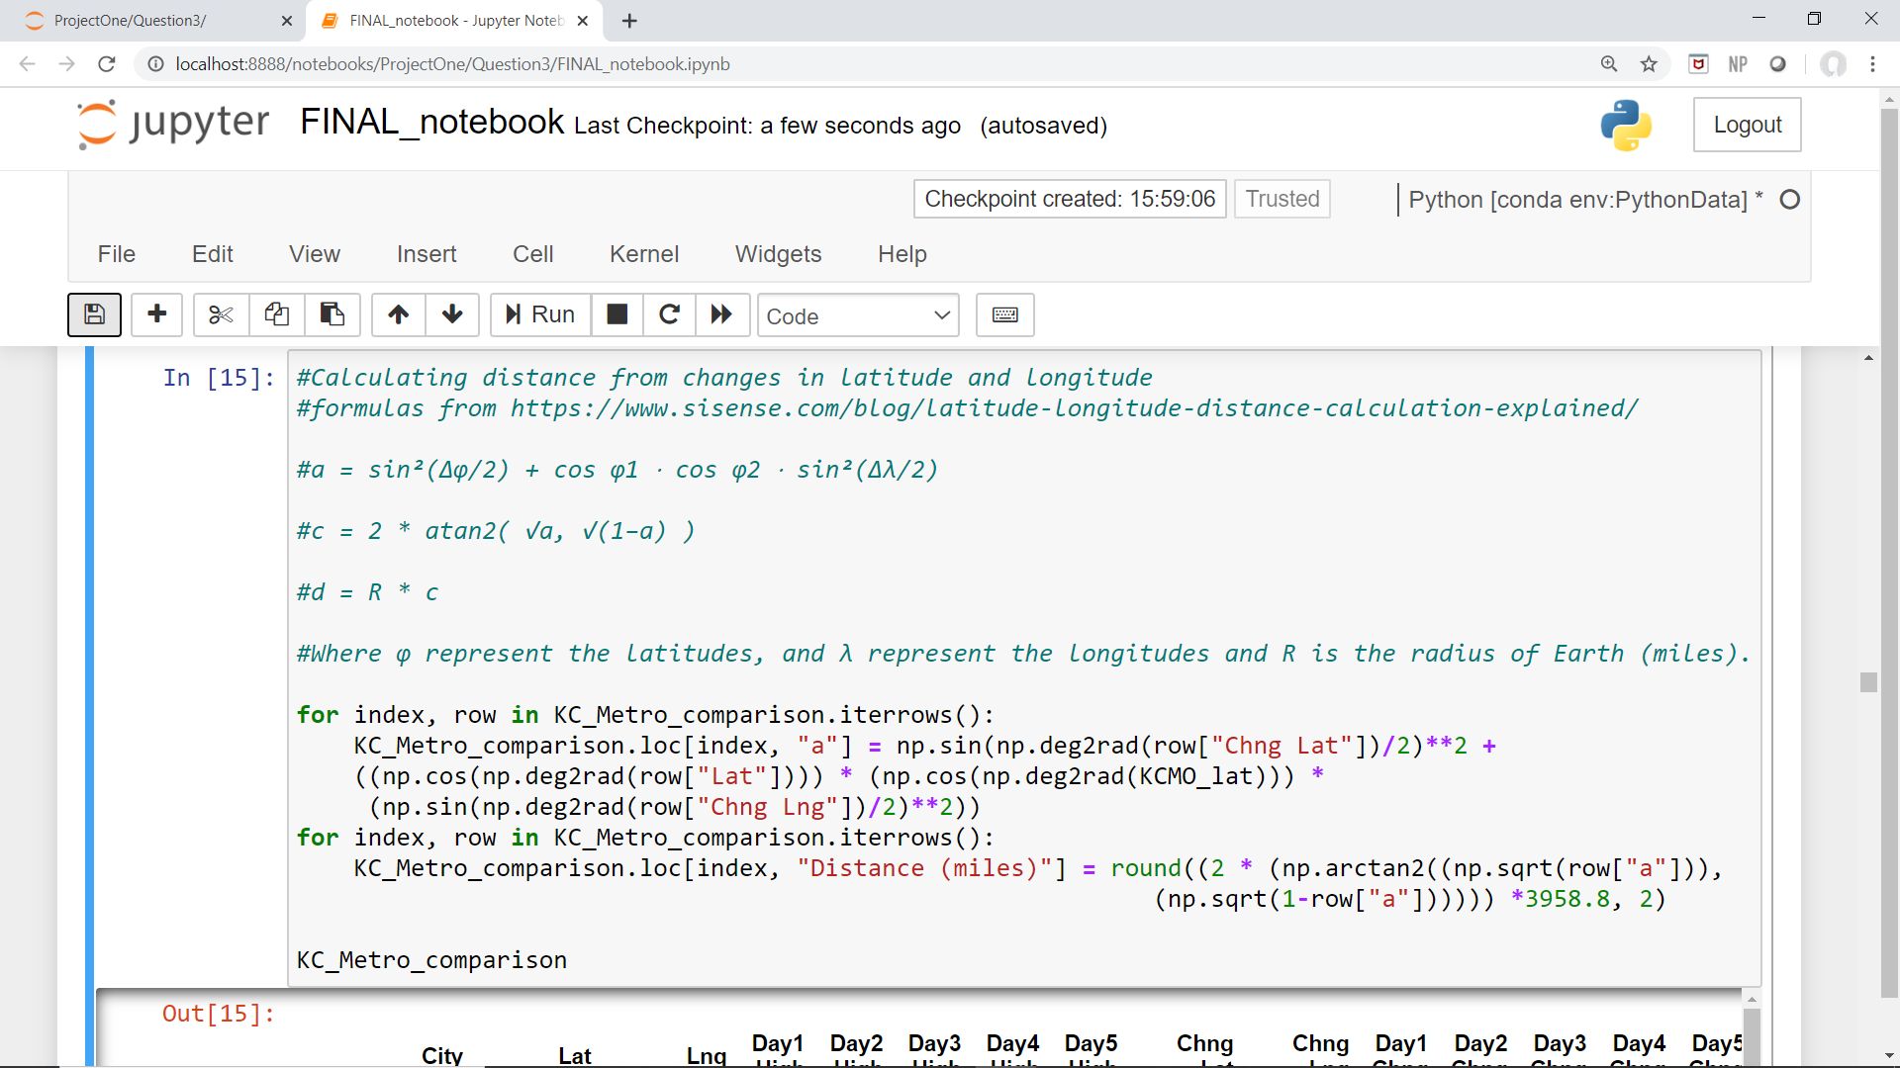
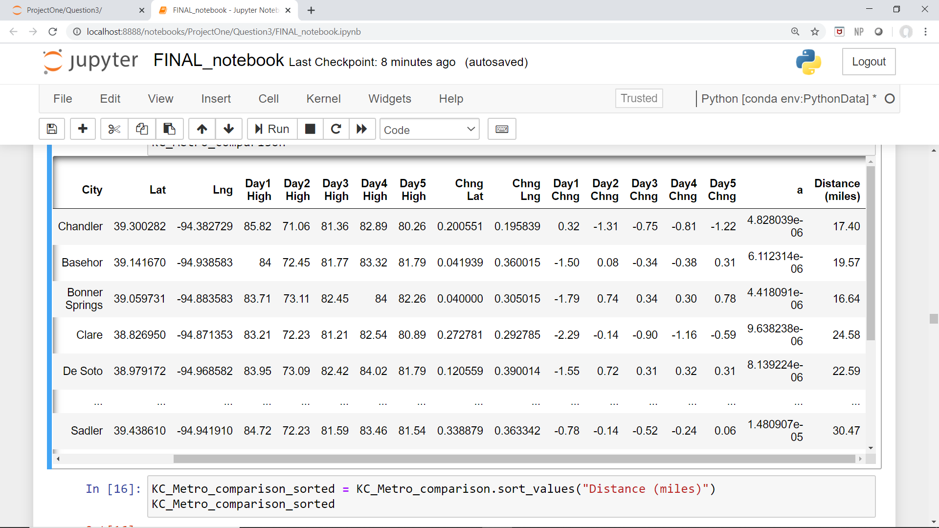
Calculate distance in miles of each city from Kansas City, MO
Equations to convert change in latitude and longitude to distance.
Final dataframe used in analysis shown

Slide 24
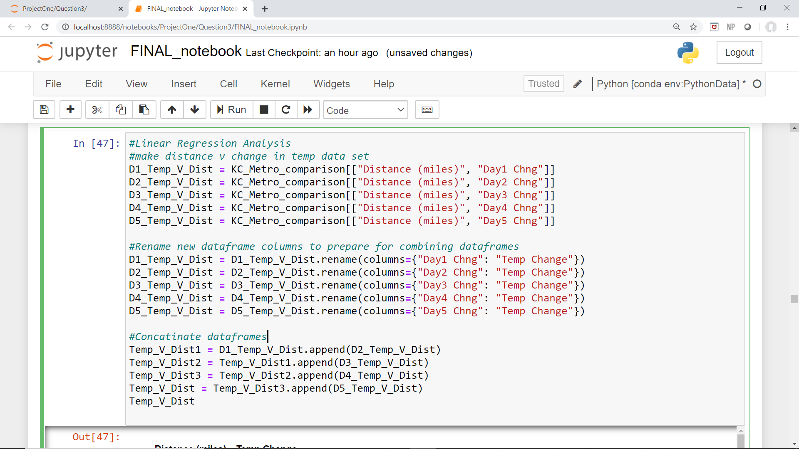
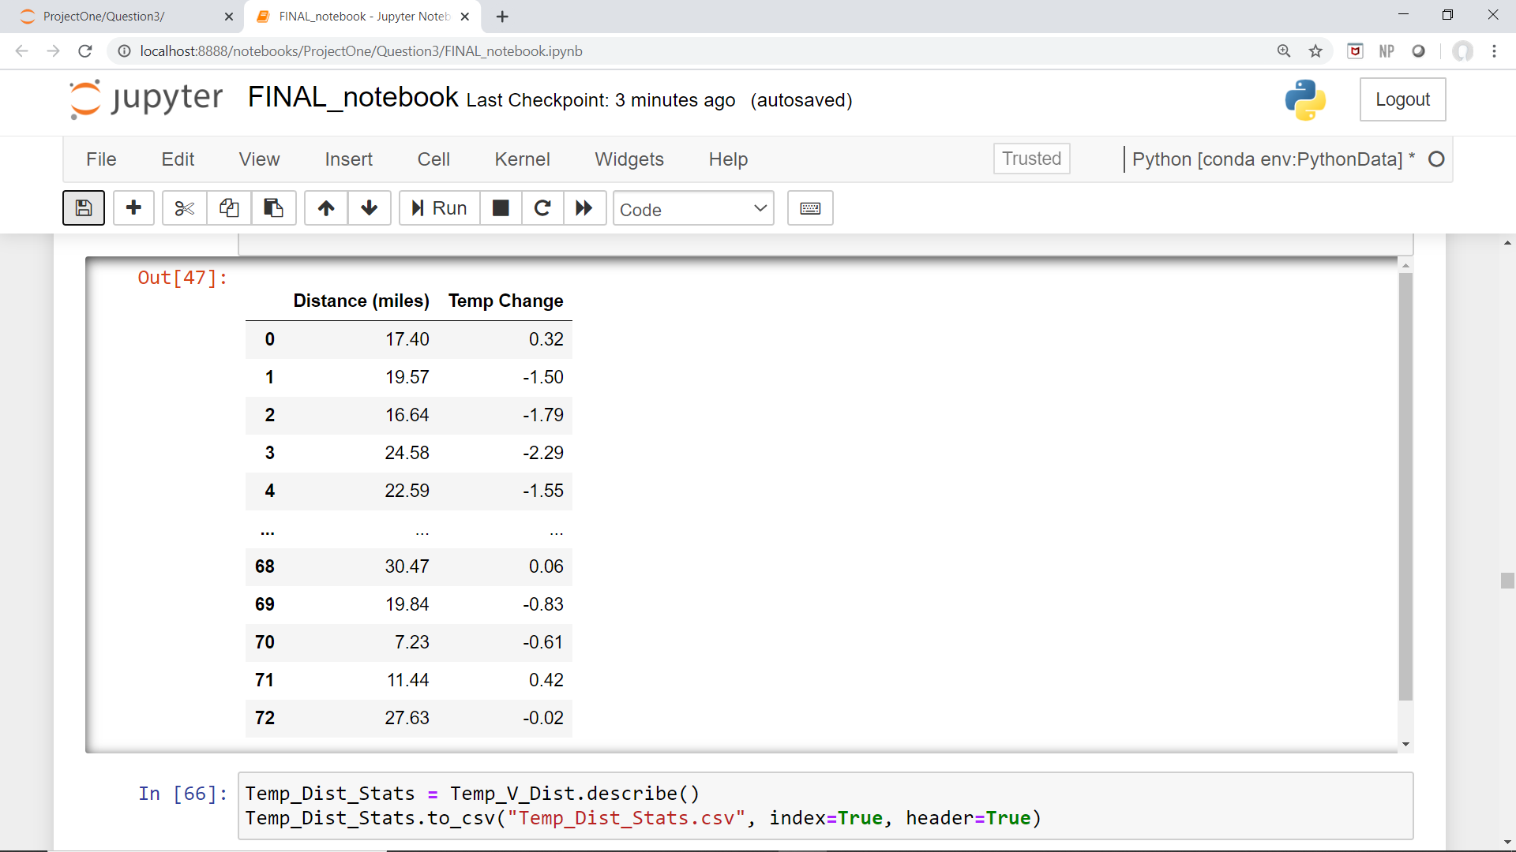
Prepare distance and temperature change data for linear regression analysis.
Final result is a dataframe with 2 series of data showing distance and change in temperature.

Slide 25
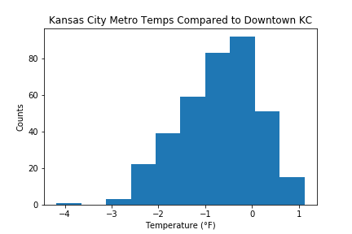

Slide 26
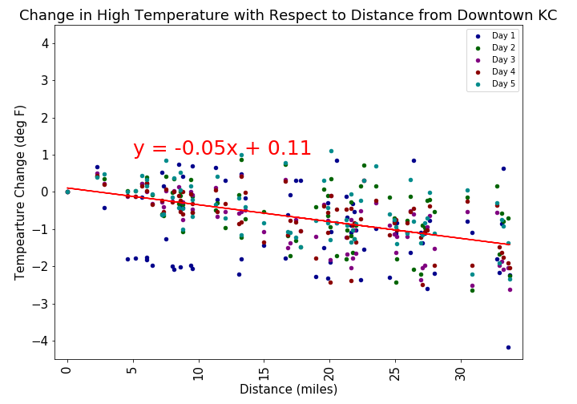
R-squared = 0.24

Slide 27
Conclusions
The average temperature within 30 miles of downtown Kansas City, MO is 0.7 degrees cooler than downtown KC, with a mode of 0.6 degrees cooler and a standard deviation of 0.84.
Temperatures as you travel a distance away from Kansas City, MO decrease slightly the further you are from the city, but with a correlation r squared coefficient of 0.24, there is no true correlation between distance from KC, MO and temperature within the KC metropolitan area.
Assumptions: As you travel away from downtown Kansas City, the population density decreases. I did pull census data for population by zip code and plotted this on a map with temperature data. However, the visualizations were unclear and time constraints prevented further analysis with this data set.

Slide 28
Data limitations and Recommendations
Limitations:
Data is limited to Kansas City metro temperatures over the past 5 days. This is a very narrow scope of data.
Recommendations:
I recommend looking at more dates, seasonal trends, and expanding the dataset to investigate other large metropolitan area.
Challenges:
Population data: To address population density, I also queried population data from the census bureau. Census data was presented by zip code, so I used the latitude and longitude of each zip code to layer population density on a map with temperature markers. The data was difficult to discern because markers overlapped and covered the population density layer and the population density layer was so compact the data points overlapped a great deal.
Historical temperature data: I also looked at climate data from the National Oceanic and Atmospheric Administration database. This showed historical monthly averages from present dating by to the early 1970’s. However, upon investigation the “average” temperature for each month was derived from the monthly high and monthly low temperatures rather than averaging daily high temperatures. OpenWeather API historical data requires subscription fees, so I did not use this source to explore historical temperature data.

